Slide 1
The Professional Branch of ΑΧΣ
Initiation is only one day.
The collegiate experience is just a few years.
Brotherhood lasts for a lifetime

Slide 2
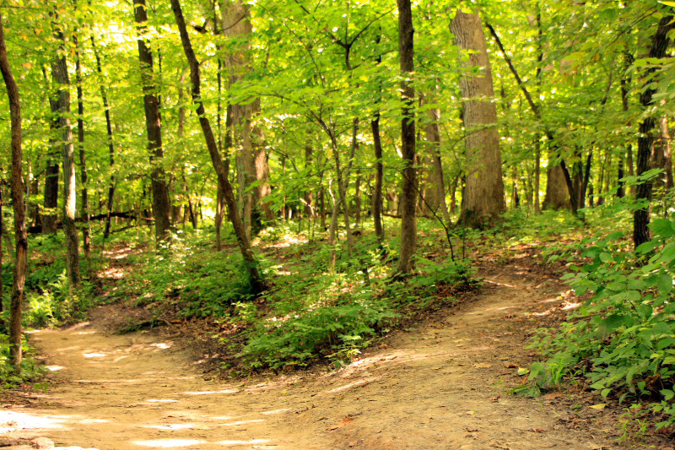
…. throughout our mortal lives.
You can continue to be active with ΑΧΣ!
Graduate School
Professional Chapters & Groups
District & National Committees
Run for an elected office
You’ve graduated. Now what? What’s the next step for you?

Slide 3
But first, update your information!
Update your details with the National Office!
Please use info that won’t expire– permanent email and mailing addresses, phone number
Don’t forget to update your address with the US Postal Service too!
Update your AlphaChiSigma.org profile
Collegiate chapters– fill out the PBI (Professional Branch Induction) form each year
Even if a Professional Branch Recognition (PRC) or Professional Induction Ceremony (PIC) are not conducted.

Slide 4
Going to graduate or professional school?
Your ΑΧΣ brothers are here to help you through!
Stay active with a local collegiate chapter!
You choose your Branch– Collegiate or Professional– determined by where you pay dues.
No active Collegiate Chapter? Consider establishing one!
Contact expansion@alphachisigma.org
Join a local Professional Group or Chapter!
Check AlphaChiSigma.org or The Hexagon for contact info
No Professional group/chapter? – establish a new one! Contact proexpansion@alphachisigma.org for help

Slide 5
Heading to the workforce?
You don’t have to be “a real chemist” to be active in the Professional Branch
An education in chemistry prepares you for many different careers
Different experiences makes the Fraternity stronger
Join a Professional Group or Chapter
Family involvement
Flexible time commitments and responsibilities
If no active Chapter consider helping to start one
Contact proexpansion@alphachisigma.org for help
Join a committee or run for office

Slide 6
How to become an Active Professional
To be an active Professional Member, you must make an annual contribution:
$25/year for recent graduates, graduate students
$50/year in later years
Allows you to hold positions and vote in Professional Chapters, vote for PRs, continue receiving all issues of The Hexagon
Your annual contribution enriches the Fraternal experience for generations to come
Examples: continued expansion efforts, higher quality member cards & certificates for new Brothers, The Hexagon
5% of your donation is given to your initiating chapter.
Your contribution is tax-deductible-- ΑΧΣ is a nonprofit 501(c)3 educational organization
Check into matching contributions from your employer (contact HR) and upsize your contribution!

Slide 7
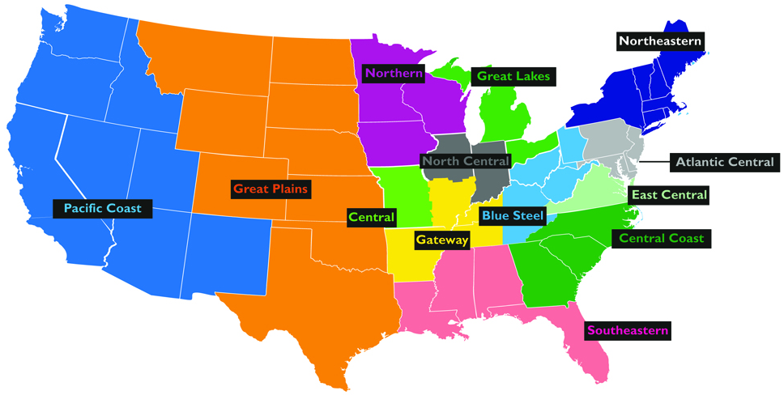
Where is the Professional Branch?
Current Professional Chapter Current Professional Group
as of October 2016

Slide 8
Professional Chapters & Groups
Chapters vs Groups: What’s the difference?
Chapter: at least 8 active Brothers, Bylaws, report to the NO, elect Officers, represented in Grand Chapter, required to have at least 3 meetings/year
Group: at least 5 active Brothers, hold regular meetings– stepping stone to Chapterhood
What kind of things do Pro Chapters & Groups do?
Fellowship and fun
Outreach and community service
Aid local Collegiate Chapters, aid in Initiations and PICs
Network with other local professional groups
Family involvement, flexible time commitment
No local Professional Group?
Expansion soon– the windfall of recent Collegiate expansion efforts
Consider starting your own! Contact proexpansion@alphachisigma.org for info

Slide 9
District Committees
The District Councilors need your help!
Over 50 active Collegiate Chapters (and growing!) divided into 13 Districts
Express interest in serving on a District Committee
Advise the DC– contribute to District Conclaves, aid in expansion efforts
Help local Collegiate Chapters
Contact your District Councilor (email addresses) or email national@alphachisigma.org to volunteer!

Slide 10
National Committees
Check website for active Committees
Some are standing, others are formed for a specific purpose and dissolve afterward
Some examples of standing Committees:
Scholar Award
Leadership Development
Housing
Expansion
Nominations
National Ritual
Scout Activity
Special Needs
Obligations & time commitments varies
Contact national@alphachisigma.org to express interest!

Slide 11
Professional Representatives
Professional Representatives (PRs) advocate for Professional Brothers at-large on Grand Chapter matters
Nationally-elected, serve 2 year term
Typically but not always in regions not represented by a Professional Chapter/Group
Duties as assigned by SC, serve on National and District Committees, aid in Collegiate and Professional Branch expansion and transition efforts.
Nominations Committee is responsible for solicitation & ballot. If you want to be considered for nomination, email national@alphachisigma.org

Slide 12
Contribute to the Reserve Fund
Donate to the Reserve Fund and become an active Professional Brother for life.
Reserve Fund helps long-term financial stability of the Fraternity.
Brothers who donate $2000 or more to the Reserve Fund over a 10-year period are granted active status for life
Also tax-deductible!
Consider planned giving

Slide 13
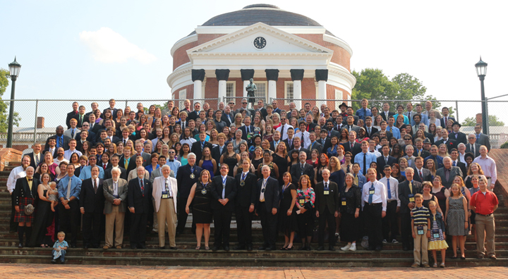
ΑΧΣ Membership is for life. What will you do now?

